Slide 1
Makana
QR code placement
(Apra to create)
edimaudo@gmail.com

Slide 2
Makana mean Gift in Hawaiian

Slide 3
Donation Overview

Slide 4
Overview

Slide 5
Donation Insights

Slide 6
Overview

Slide 7
Overview

Slide 8
Donor Portfolio

Slide 9
Donation Opportunities

Slide 10
Gift Forecasting

Slide 11
Next Best Gift

Slide 12
Appendix

Slide 13
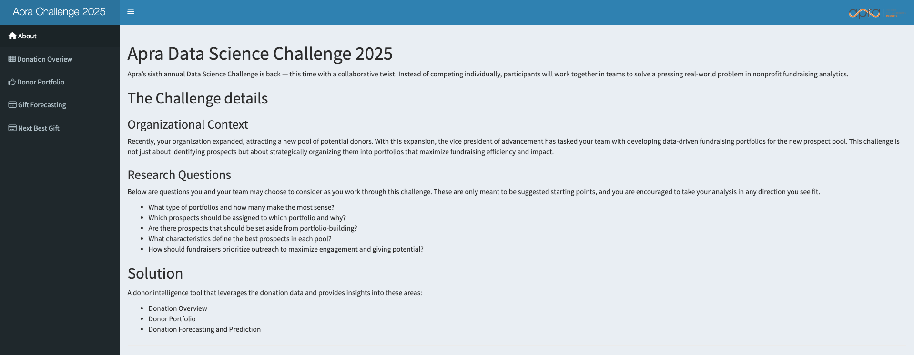
About Section

Slide 14
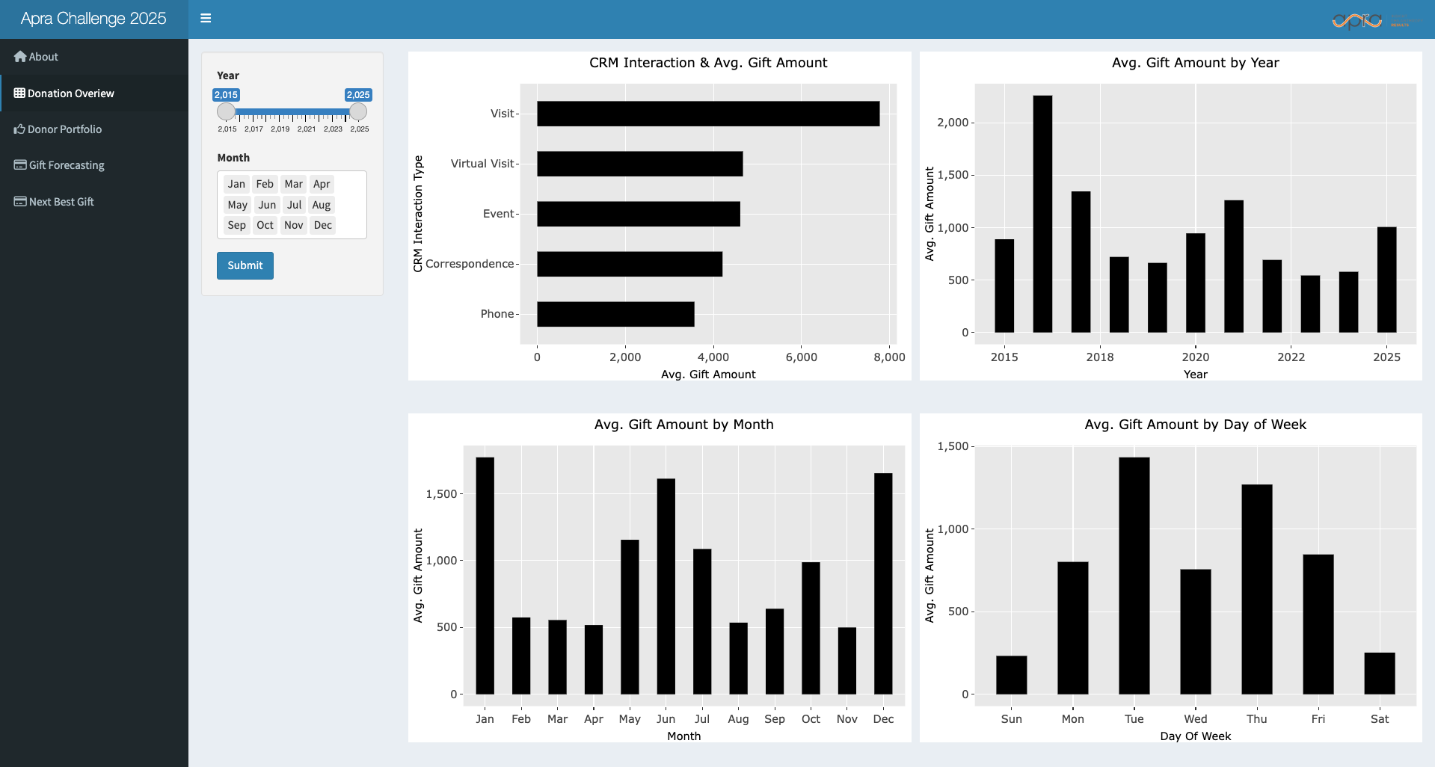
Donation Overview Section

Slide 15
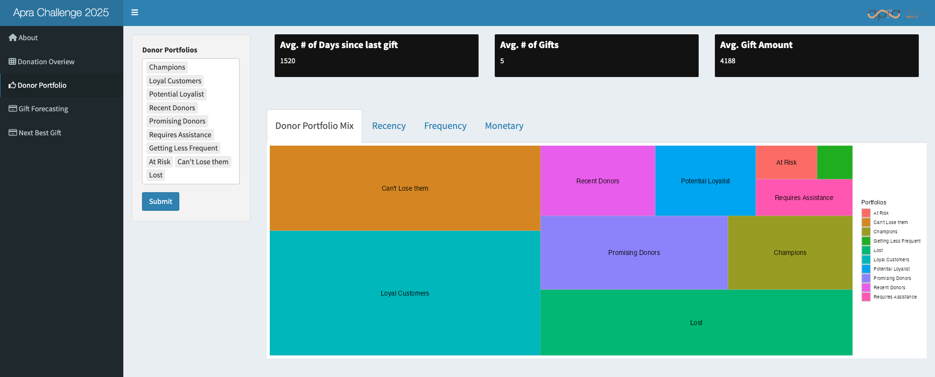
Donor Portfolio Section

Slide 16
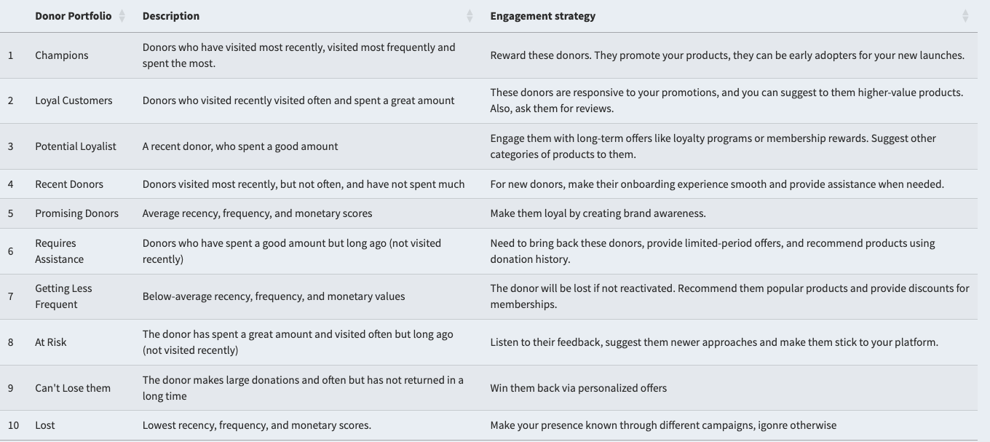
Donor Portfolio Section

Slide 17
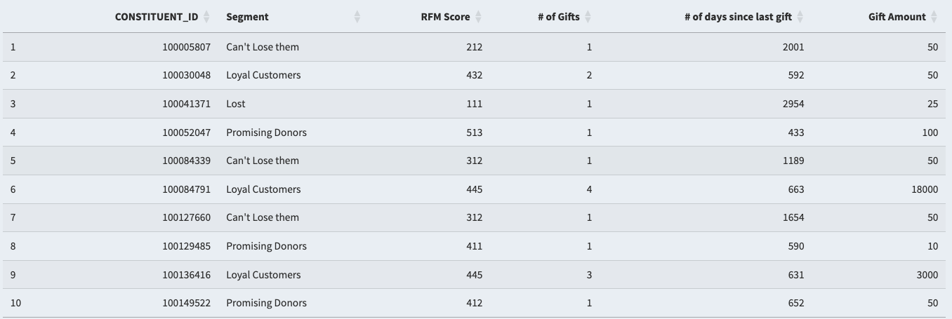
Donor Portfolio Section

Slide 18
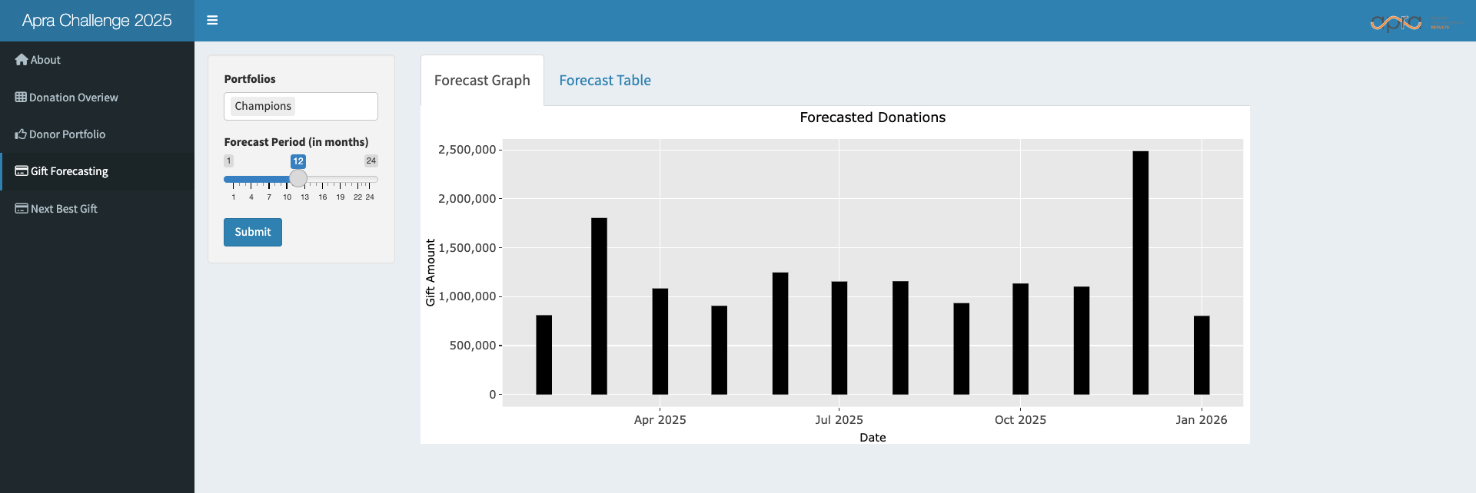
Gift Forecasting Section

Slide 19
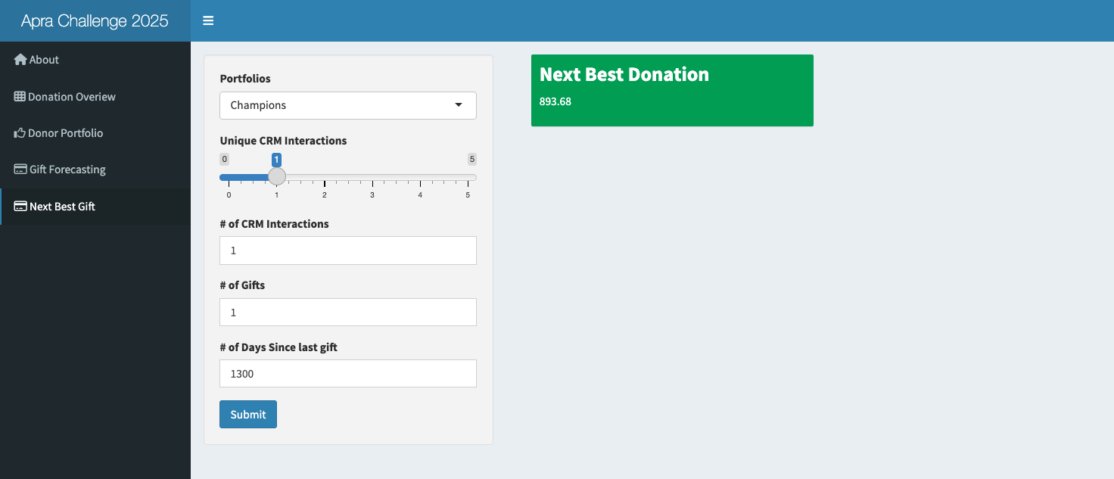
Gift Prediction Section

